Slide 1
Covenants of the Bible

Slide 2
The New Covenant
Part 2

Slide 3
What Did Jesus Do?
He was the Bridegroom who died for His adulterous bride to make her a widow so He could betroth her again
He brought the Firstborn of Ephraim back into the Covenant House
He was the Passover “son” who re-opened the door to the Covenant
The Lamb of Passover
The Goat of Yom Kippur

Slide 4
Jesus’ Other Works
He paid for the broken Abrahamic Covenant
He was the Yom Kippur goat for sin
He is the High Priest of the Heavenly Tabernacle
under the order of Melchizedek
He is Messiah - but which one?

Slide 6
Jesus: The Yom Kippur Sacrifice
Day of Atonement
Forgivness for Intentional Sin
willful, rebellious sin
unintentional sin or sin against a brother is forgiven by repentance and recompense
Only YHVH can forgive willful, rebellious sin against Him
This is done once a year on Yom Kippur

Slide 7
The Temple Sacrifices
The five offerings in the Temple that covered unintentional sin. Free will offerings.
Olah offering - The burnt offering. A dedication offering.
Mincha offering - The flour offering, no blood
Shelamim - the peace offering. A shared meal
Chatat - the sin offering for unintentional weaknesses and failures.
Asham - the trespass offering, if you trespass towards your neighbor. Often given for fraud.

Slide 8
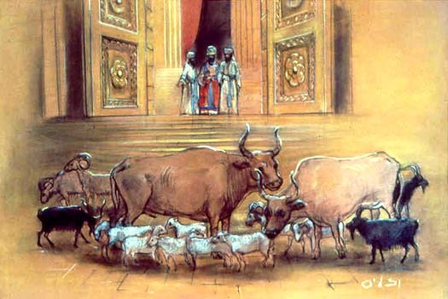
The Yom Kippur Sacrifice
There are 16 different animals sacrificed
The two main ones are a bullock and the goat
The bullock is sacrificed first for the atonement for the Priests

Slide 9
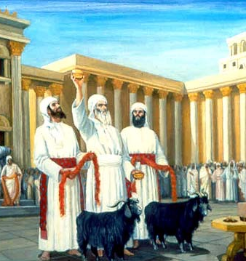
The Yom Kippur Sacrifice
Two goats are chosen
one for the LORD
one for Azazel
The goat for the LORD is sacrificed
The “scapegoat” is sent into the wilderness to carry the sins of Israel

Slide 10
The Yom Kippur Sacrifice
Two men were presented to Pilate
Yeshua and Barabbas
Yeshua - the son of the Father
Bar - Abbas - the son of the Father
One released, the other crucified

Slide 11
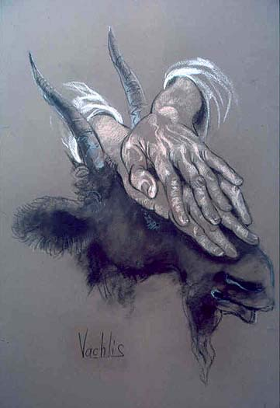
The Yom Kippur Sacrifice
The sins are laid on the head of the Scapegoat and sent into the wilderness
The sins are also laid on the head of the sacrificial goat before he is killed

Slide 12
Jesus took our sins
1 Peter 2:24, 25
and He Himself bore our sins in His body on the cross, so that we might die to sin and live to righteousness; for by His wounds you were healed. For you were continually straying like sheep, but now you have returned to the Shepherd and Guardian of your souls.

Slide 13
The Heavenly Temple
Yeshua took His blood to cleanse the Heavenly temple/Tabernacle
Yom Kippur is the only time all the altars were purified from sin
altar of burnt offering
incense altar
Ark of the Covenant
Yeshua cleansed the Heavenly temple from sin with His own blood

Slide 14
Melchizedek Priesthood

Slide 15
Melchizedek Priesthood
Priesthood
Kingship
Firstborn
House of Ephraim
our Melchizedek Priest!

Slide 16
He is now our High Priest
Hebrews 7, 8, and 9 all discuss the role of Yeshua as High Priest
Ch. 7: He is an eternal priest under the order of Melchizedek
Ch. 8: His Priesthood officiating the Yom Kippur ceremony in Heaven is better than the Levitical Priesthood
Ch 9: His sacrifice is an eternal sacrifice because He used his own blood
He will officiate as High Priest until it is time for Him to return to the earth.

Slide 17
Yeshua as Messiah

Slide 18
One Messiah, Two Comings

Slide 19
Two Messiahs, One Coming

Slide 20
Two Separate Messiahs
Messiah ben Joseph
Messiah ben David

Slide 21
Messiah ben Joseph
In Jewish eschatology Messiah ben Joseph, also known as Messiah ben Ephraim, is a Tzaddik (righteous man) from the tribe of Ephraim and a descendant of Joseph.
According to Talmud, the need for his appearance will depend on the spiritual condition of the Jewish people. If they are worthy, he will come riding on the clouds of heaven. If not worthy, he will come lowly, riding on a donkey.

Slide 22
Messiah ben Joseph
He will come as the Suffering Servant - a “tzaddik” who could die on behalf of the nation.
[In this case, we see Jesus as dying in Ephraim’s place, so Yah can betroth her again.]
He will go into the Hall of Atonement in Gan Eden and take upon himself all the sickness, pain and suffering of Israel. Otherwise, the people of Israel would not be able to bear their own suffering.
after his death a period of great calamities will befall Israel.[6] God will then resurrect the dead and usher in the Messianic Era of universal peace.

Slide 23
Isaiah 53
In fact, it was our diseases he bore, our pains from which he suffered; yet we regarded him as punished, stricken and afflicted by God.
But he was wounded because of our crimes, crushed because of our sins; the disciplining that makes us whole fell on him, and by his bruises we are healed.
We all, like sheep, went astray; we turned, each one, to his own way; yet Adonai laid on him the guilt of all of us.

Slide 24
Messiah ben David
Messiah ben Joseph will come first, to fight for the Land and die for the nation of Israel
Messiah ben David will come at the end of days riding on a white horse to reign as king over Israel
He will come “riding on the clouds of heaven”
He will rebuild the Millennial Temple

Slide 25
Yeshua Has Different Roles

Slide 26
The Roles of Messiah
Past: He finished His work as Messiah ben Joseph, the Firstborn
Present: He is officiating as High Priest of Heaven
Providing permanent atonement for sin
Mediating for us until He returns
Future: Will ride into Jerusalem on a white horse as Messiah ben David, and reign as King of all Israel!

Slide 27
Yeshua’s Current Role
He is seeking those who are “lost”
Gentile Ephraim outside of Covenant
Judah outside of the Covenant
Gentiles who never were in Covenant
The Good Shepherd
A Fisher of Men
We are to follow Him as disciples

Slide 28
The Good Shepherd
Ezekiel 34:11-16 - “‘For here is what Adonai Elohim says: “I am taking over! I will search for my sheep and look after them, myself. 12 Just as a shepherd looks after his flock when he finds himself among his scattered sheep, so I will look after my sheep. I will rescue them from all the places where they were scattered when it was cloudy and dark. 13 I will bring them back from those peoples, gather them from those countries and return them to their own land. … 15 Yes, I will pasture my sheep; and I will let them rest” says Adonai Elohim. 16 “I will seek the lost, bring back the outcasts, bandage the broken, and strengthen the sick. But the fat and the strong I will destroy — I will feed them with judgment.”

Slide 29
Jesus the Fisher of Men
Genesis 48:15, 16 - Then he blessed Yosef: “The God in whose presence my fathers Abraham and Isaac lived, the God who has been my own shepherd all my life long to this day, the angel who has rescued me from all harm, bless these boys. May they remember who I am and what I stand for, and likewise my fathers Abraham and Isaac, who they were and what they stood for. And may they grow into teeming multitudes on the earth.”

Slide 30
Jesus the Fisher of Men
And may they grow into teeming multitudes on the earth.”
Hebrew: “May they multiply, may they grow like a multitude of fish; may they be teaming multitudes
Jesus is the Great Fisherman, fishing for “Ephraim” and “Manasseh”
Jesus taught His disciples to be “fishers of men”

Slide 31
Remember Ephraim and Manasseh?
Israel blesses Ephraim and Manasseh
Manasseh would be great, but Ephraim would become “a multitude of nations.”
Hebrew: Melo ha’goyim
The Fullness of the Gentiles

Slide 32
Fullness of the Gentiles
Romans 11:25-26 “For I do not want you, brethren, to be uninformed of this mystery-- so that you will not be wise in your own estimation-- that a partial hardening has happened to Israel until the fullness of the Gentiles has come in.”
And in this way all Israel will be saved, as it is written,“The Deliverer will come from Zion,he will banish ungodliness from Jacob”;

Slide 33
If you haven’t figured it out yet…
We are the “fullness of the Gentiles”
We are Ephraim - the lost 10 tribes!

Slide 34
The Work of Yeshua in Covenant
He was the Bridegroom who died for His adulterous bride
He redeemed the Firstborn of Ephraim
He was the Passover “Lamb” who re-opened the door to the Covenant
He was the Yom Kippur “Goat” who cleansed the Heavenly Temple and the sins of Israel
He is the Melchizedek Priest and Mediator
He is our coming Messiah
He will reign as King over all Israel!

Slide 35
Yeshua in The Covenants
Adam - Jesus was the Second Adam
Noah - Jesus was the rainbow - the Water and Light
Abraham, Isaac, Jacob - Jesus walked between the pieces and died to pay for the broken covenant
Moses - Jesus is a Prophet like unto Moses
He redeemed the Firstborn as the Passover Lamb
Jesus died so God could marry the Bride again
David - Jesus is our eternal King from the Tribe of Judah
Phinehas - Jesus is the heavenly Melchizedek High Priest of the broken Vav
New/Renewed Covenant - Jesus embodies and fills all the Covenants!

Slide 36
The “Story” of Covenant
YHVH created the earth and put Adam in charge. He cleansed the earth with water and preserves His”Adam”. God then finds a man who He can cut a covenant with and provides him a house, a family, and a piece of land. He raises up a Bride, then provides her with a wedding Ketubah and a Kingdom with a constitution. He establishes an eternal Kingship and eternal Priesthood. When the people break covenant, He raises up Messiah ben Joseph to die, to re-marry His Bride. When all 12 tribes of the two houses of Israel and Judah have come back into the Covenant, Yeshua will return as Messiah ben David to establish the Kingdom of Israel. He will be the King of all the earth and rule the world from Jerusalem with His resurrected Bride.

Slide 37
Will you join the Story?

